Slide 1

CSE- 104
Structured Programming Lab
Lab : 08 Structures in C
Fahad Ahmed
Lecturer, Dept. of CSE
E-mail: fahadahmed@uap-bd.edu

Slide 2
Mid Exam Group B1+B2
Date: 06-March-2021 10.00 AM
Type: MCQ (Program output or finding error)
Number of Question : 15
Time: 15 Min
Loop to String

Slide 3
Structure
A structure is a user defined data type. A struct (or structure) is a collection of variables (can be of different types) under a single name.
How to define structures?
struct [structure tag] {
member definition;
member definition;
...
member definition;
} [one or more structure variables];
struct Person {
char name[50];
int citNo;
float salary;
};

Slide 4
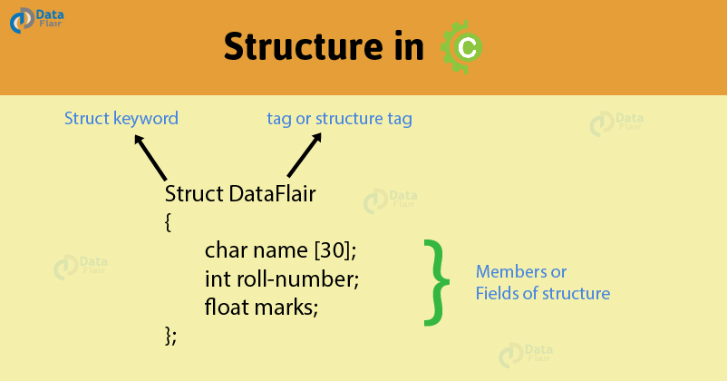
Structure

Slide 5
Structure
Create struct variables
When a struct type is declared, no storage or memory is allocated. To allocate memory of a given structure type and work with it, we need to create variables.
struct Person
{
char name[50];
int citNo;
float salary;
};
int main()
{
struct Person person1, person2, p[20];
return 0;
}
struct Person
{
char name[50];
int citNo;
float salary;
} person1, person2, p[20];

Slide 6
Structure
Access members of a structure
There are two types of operators used for accessing members of a structure.
. Member operator
-> Structure pointer operator

Slide 7
Structure
How to initialize structure members? Structure members cannot be initialized with declaration. For example the following C program fails in compilation.
struct Point
{
int x = 0; // COMPILER ERROR: cannot initialize members here
int y = 0;
// COMPILER ERROR: cannot initialize members here
};
The reason for above error is simple, when a datatype is declared, no memory is allocated for it. Memory is allocated only when variables are created.
Structure members can be initialized using curly braces ‘{}’.

Slide 8
Example
#include<stdio.h>
struct Point
{
int x, y, z;
};
int main()
{
struct Point p1 = {0, 1};
p1.z = 20;
printf ("x = %d, y = %d, z = %d ", p1.x, p1.y, p1.z);
return 0;
}

Slide 9
Example
What is designated Initialization?
Designated Initialization allows structure members to be initialized in any order.
#include<stdio.h>
struct Point{
int x, y, z;
};
int main()
{
struct Point p1 = {.y = 0, .z = 1, .x = 2};
struct Point p2 = {.x = 20};
printf ("x = %d, y = %d, z = %d\n", p1.x, p1.y, p1.z);
printf ("x = %d", p2.x);
return 0;
}
This feature is not available in C++ and works only in C.

Slide 10
Keyword typedef
typedef is a keyword used in C language to assign alternative names to existing datatypes. Its mostly used with user defined datatypes, when names of the datatypes become slightly complicated to use in programs. Following is the general syntax for using typedef,
struct point{
int x;
float y;
};
int main() {
struct point p1, p2;
}
typedef struct point{
int x;
float y;
} point_var;
int main() {
point_var p1, p2;
}
is equivalent to

Slide 11
size of following structure
What will be the size of following structure?
struct employee
{
int emp_id;
int name_len;
char name[0];
};
4 + 4 + 0 = 8 bytes.
And what about size of “name[0]”. In gcc, when we create an array of zero length, it is considered as array of incomplete type that’s why gcc reports its size as “0” bytes. This technique is known as “Stuct Hack”. When we create array of zero length inside structure, it must be (and only) last member of structure.

Slide 12
Array of structures
Array of structures?
#include<stdio.h>
struct Point
{
int x, y;
};
int main()
{
// Create an array of structures
struct Point arr[10];
// Access array members
arr[0].x = 10;
arr[0].y = 20;
printf("%d %d", arr[0].x, arr[0].y);
return 0;
}

Slide 13
Passing structs to functions
#include <stdio.h>
struct student {
char name[50];
int age;
};
void display(struct student s) {
printf("\nDisplaying information from function:\n");
printf("Name: %s\n", s.name);
printf("Age: %d\n", s.age);
}
int main() {
struct student s1;
printf("Enter name: ");
gets(s1.name);
printf("Enter age: ");
scanf("%d", &s1.age);
display(s1);
return 0;
}

Slide 14
Passing structs array to functions
#include <stdio.h>
struct student
{
int id;
float cgpa;
} ;
void show(struct student s[])
{
int i;
for(i=0; i<3; i++)
printf("function id: %d, CGPA: %.2f\n\n",s[i].id, s[i].cgpa);
}
int main()
{
struct student s[3];
int i;
for(i=0; i<3; i++)
{
s[i].id=i+101;
printf("Enter cgpa for student %d: ",i+1);
scanf("%f", &s[i].cgpa);
}
show(s);
}

Slide 15
Exercise using structure array and function
Program to calculate distance between two points in 3 D
Given two coordinates (x1, y1, z1) and (x2, y2, z2) in 3 dimension. The task is to find the distance between them. Variable are will be floating point.
x1 = 2; y1 = -5; z1 = 7;
x2 = 3; y2 = 4; z2 = 5;
Distance: 9.273619

Slide 16
Exercise
Program to calculate distance between two points in 3 D
#include<stdio.h>
#include<math.h>
struct distance
{
float x, y,z;
};
int main()
{
struct distance d1, d2 ;
scanf("%f %f %f", &d1.x, &d1.y, &d1.z);
scanf("%f %f %f", &d2.x, &d2.y, &d2.z);
float res= pow(d2.x-d1.x,2)+pow(d2.y-d1.y,2)+pow(d2.z-d1.z,2);
res=sqrt(res);
printf("Distance: %f\n", res);
return 0;
}

Slide 17
Exercise solution
#include <stdio.h>
struct point
{
float x,y,z;
} ;
void calculation(struct point p[])
{
float distance;
distance= pow((p[1].x-p[0].x),2)+ pow((p[1].y-p[0].y),2) +pow((p[1].z-p[0].z),2);
distance=sqrt(distance);
printf("Distance : %f\n\n", distance);
}
int main()
{
struct point p[2];
int i;
for(i=0; i<2; i++)
{
printf("Enter x y z for point %d: ",i+1);
scanf("%f %f%f", &p[i].x,&p[i].y,&p[i].z);
}
calculation(p);
}

Slide 18
Exercise
C Program to Store Information of 3 Students Using Structure
Roll are generated atomically,
first_name and marks are user input.

Slide 19
Project Idea
Student Record
Write a C program to keep records and perform statistical analysis for a class of 20 students. The information of each student contains ID, Name, Sex, quizzes Scores (2 quizzes per semester), mid-term score, final score, and total score. The program will prompt the user to choose the operation of records from a menu as shown below: ============================================ Menu
============================================ 1. Add student records 2. Delete student records 3. Update student records 4. View all student records 5. Calculate an average of a selected student’s scores 6. Show student who gets the max total score 7. Show student who gets the min total score 8. Find student by ID 9. Sort records by total scores

Slide 20
Exercise
#include <stdio.h>
struct student
{
int roll;
char name[50];
float marks;
} ;
int main()
{
int i;
struct student s[5];
printf("Enter information of students:\n");
for (i = 0; i <3; i++)
{
s[i].roll = i + 1;
printf("\nRoll number is %d,\n", s[i].roll);
printf("Enter First name: ");
scanf("%s", s[i].name);
printf("Enter marks: ");
scanf("%f", &s[i].marks);
}
printf("\n\nDisplaying Information:\n");
for (i = 0; i <3; i++)
{
printf("\nRoll number: %d\n",s[i].roll);
printf("First name: ");
puts(s[i].name);
printf("Marks: %.2f", s[i].marks);
printf("\n");
}
return 0;
}

Slide 21
Nested Structures
Nested structure in C is nothing but structure within structure. One structure can be declared inside other structure as we declare structure members inside a structure. The structure variables can be a normal structure variable or a pointer variable to access the data.
struct address
{
char city[20];
int pin;
char phone[14];
};
struct employee
{
char name[20];
struct address add;
};
emp.add.city,
emp.add.pin
emp.add.phone
void main ()
{
struct employee emp;
}

Slide 22
Nested Structures
#include<stdio.h>
struct address
{
char city[20];
int pin;
char phone[14];
};
struct employee
{
char name[20];
struct address add;
};
void main ()
{
struct employee emp;
printf("Enter employee information?\n");
scanf("%s %s %d %s",emp.name,emp.add.city, &emp.add.pin, emp.add.phone);
printf("Printing the employee information....\n");
printf("name: %s\nCity: %s\nPincode: %d\nPhone: %s",emp.name,emp.add.city,emp.add.pin,emp.add.phone);
}

Slide 23

Thanks to All

